Slide 1
Website for sports equipment
Presented by,
Vaishnavi Pawaskar

Slide 2
introduction
The business-to-consumer aspect of electronic commerce (e-commerce) is the most visible business use of the World Wide Web.
To sell goods and services online.
A virtual store.

Slide 3
Purpose
To sell different sports equipment
All products in categorized manner
Increase business scope
Saves the time

Slide 4
requirement
Software Requirement
Windows OS with 32 bit or 64 bits
Web server software XAMPP or WAMP
(Apache), PHP, and MySQL
WordPress Application
Notepad ++
PHP 5.6.x or above - http://php.net
MySQL 5.6 or above - http://mysql.org
Hardware Requirement
Laptop
Internet connection

Slide 5
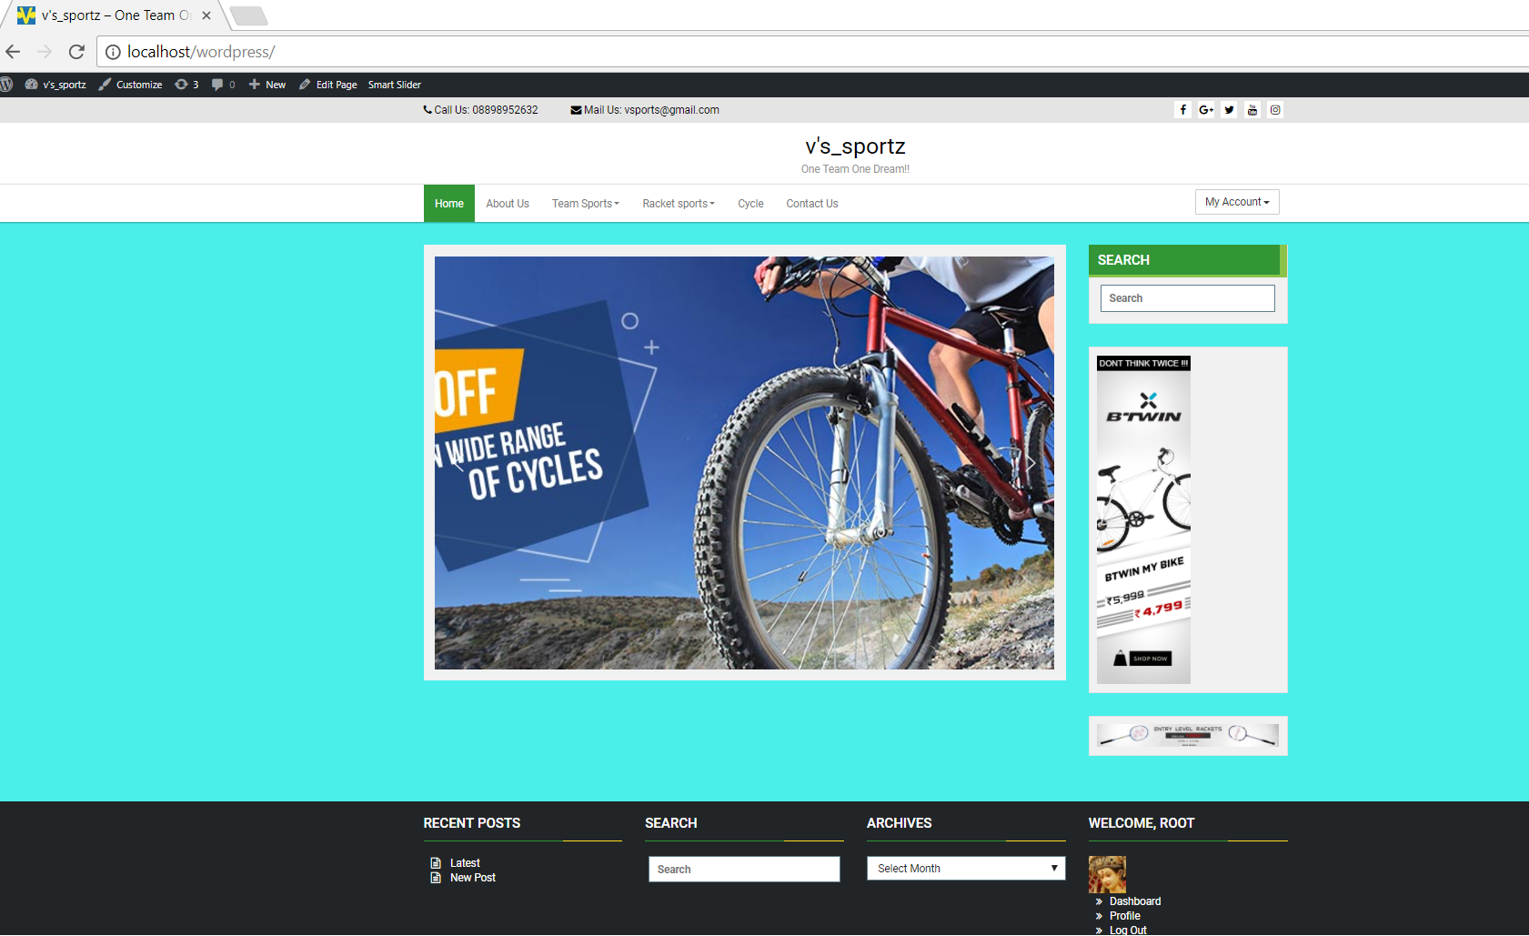
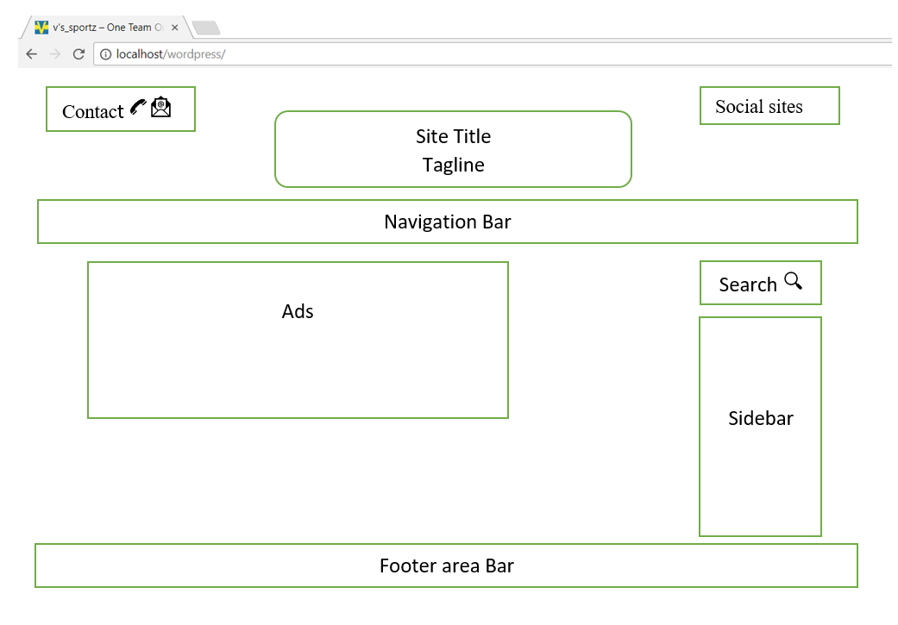
design

Slide 6
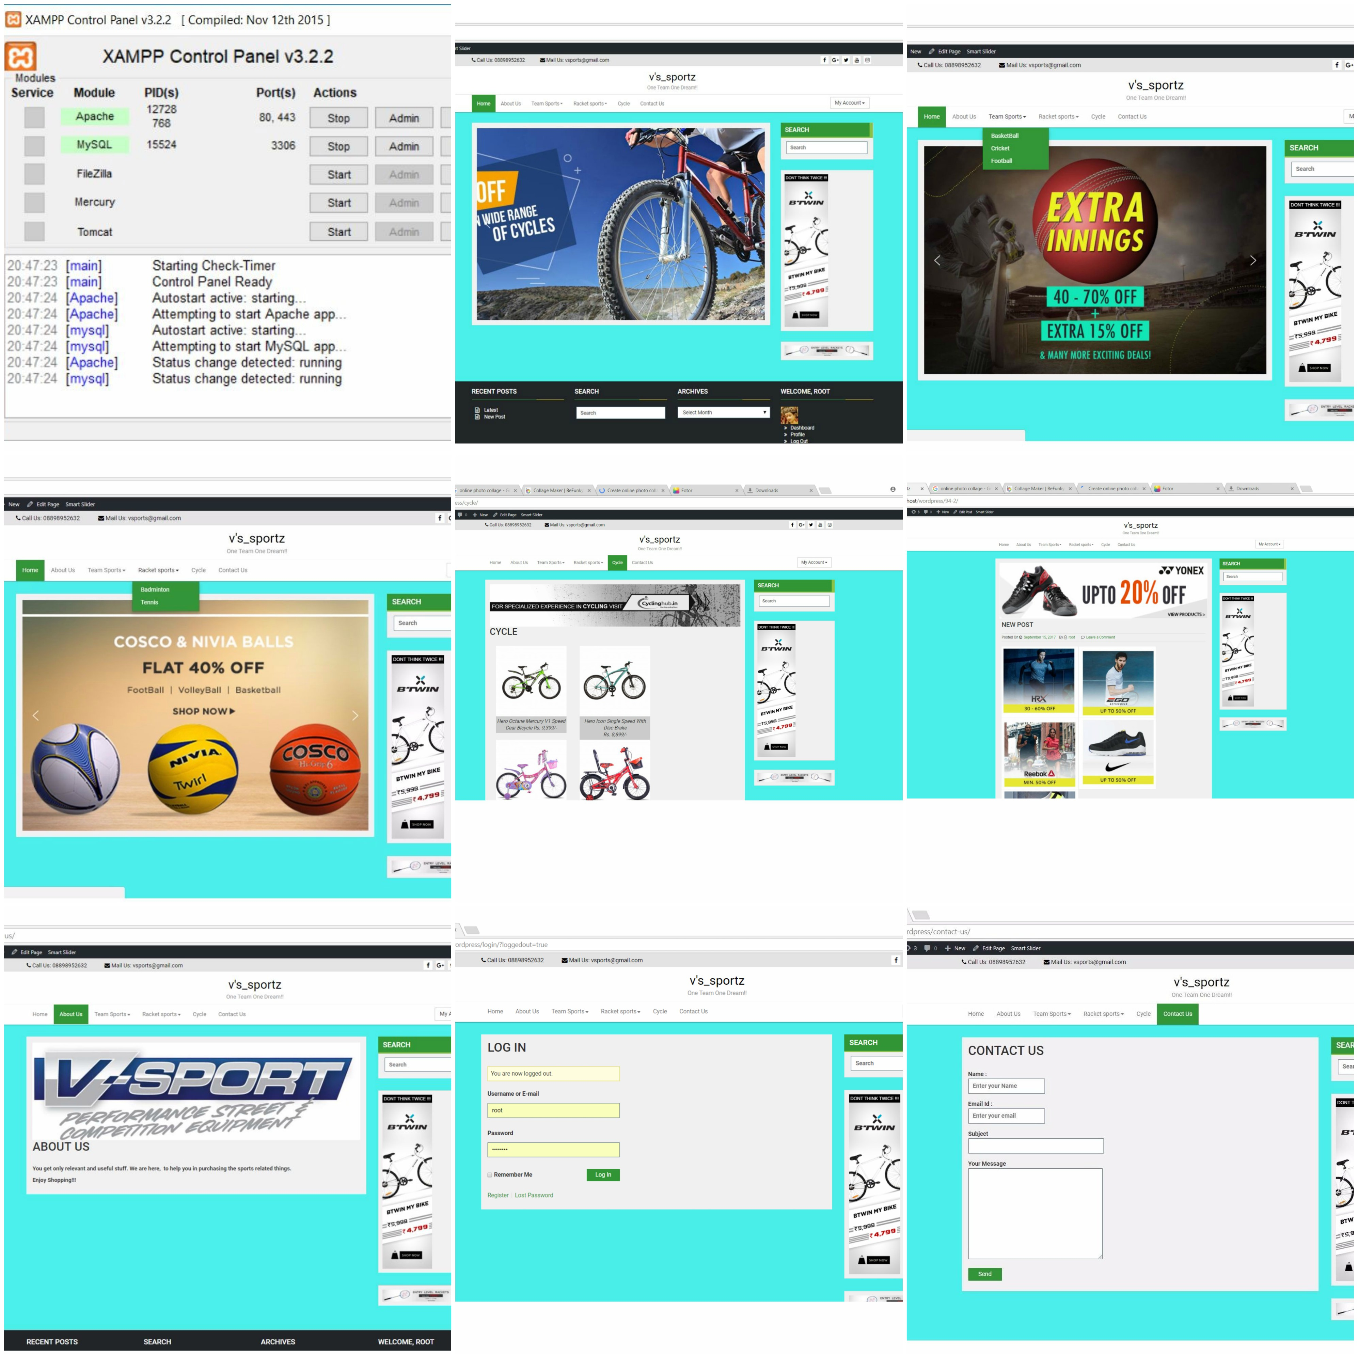
Implementation

Slide 7
Testing and maintenance
The local WordPress website will open on all browsers in laptop or pc.
System as well as website testing is done.
User registration
Attractive, simple and user friendly website

Slide 8
Future scope
E-commerce website
Additional Functionality
Payment system
Shopping cart

Slide 9
Deployment
Download and install (WAMP or XAMPP) server for your OS. Then start up both Apache and MySQL.
Download WordPress and extract the zip files in htdocs directory of XAMPP server. C:\xampp\htdocs\wordpress
Launch PHPMyAdmin from your XAMPP control panel to create a MySQL database for your installed WordPress.
Run the WordPress installer.
http://localhost/wordpress/

Slide 10


